Slide 1
Customer Retention Case Study Presentation
Flip Robo
SHREYASI SAHA

Slide 2


CONTENTS
INTRODUCTION
WHAT ARE THE BENEFITS OF CUSTOMER RETENTION
PROBLEM STATEMENT
OBJECTIVE
EXPLORATORY DATA ANALYSIS (EDA)
VISUALIZATION
OBSERVATION
CONCLUSION
C

Slide 3
Introduction
What is Customer Retention and do we really need it?
“Customer retention refers to company’s ability to turn customers into repeat buyers and prevent them from switching to a competitor”
In other words customer retention means – “To maintain the existing customers”
This happens only if there exists a positive relation between the company and the customer.
3

Slide 4
What are the benefits of Customer Retention ?
Retained customers tend to buy other services from same company.
Retained customers are known to be less price/cost sensitive
The probability of selling to an existing customer is 60-70%
The probability of selling to new prospect is 5-20%
Declined migration rates
It’s more expensive to acquire a new customer than to retain an old one.

Slide 5
Problem Statement
Customer satisfaction has emerged as one of the most important factors that guarantee the success of online store; it has been posited as a key stimulant of purchase or repurchase intentions and customer loyalty.
A comprehensive review of the literature, theories and models have been carried out to propose the models for customer activation and customer retention.
Five major factors that contributed to the success of an e-commerce store have been identified as: service quality, system quality, information quality, trust and net benefit.
The research furthermore investigated the factors that influence the online customers repeat purchase intention.
The combination of both utilitarian value and hedonistic values are needed to affect the repeat purchase intention (loyalty) positively.
The data is collected from the Indian online shoppers. Results indicate the e-retail success factors, which are very much critical for customer satisfaction.

Slide 6
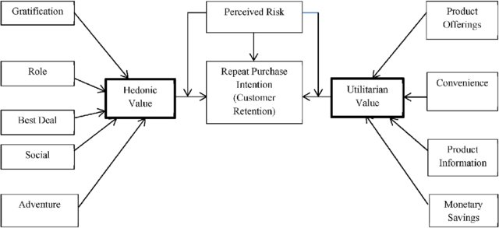
The problem statement can be represented in the form of below use case diagram as well.

Slide 7
OBJECTIVE
The objective is to apply the analytical skills to provide findings and conclusion that would help to predict customer retention for a E-Retail company using their data on users provided over period of time.
Using the model I was tasked with determining which features were most influential in loss of valuable customer and then making a plan for how the company could use this information to increase customer retention.

Slide 8
Exploratory Data Analysis (EDA)
Shape
Then I checked the shape of our dataset and found that we have a total of 269 rows and 71 different columns.
Null Values
We don’t have any null values or missing values present in our dataset.
Duplicates
There is 22% percent of duplicate records in our dataset however I have chosen to retain those information instead of removing them.
By checking the data types I came to know that all the columns have ‘object’ data type except the column representing the Pin Code which has ‘integer’ data type.
DataTypes

Slide 9
Visualization
Data visualization is defined as a graphical representation that contains the information and the data.
Data visualization is another technique of visual art that grabs our interest and keeps our main focus on the message captured with the help of eyes.
Different Types of Analysis for Data Visualization are 1. Univariate Analysis: In the univariate analysis, we will be using a single feature to analyze almost all of its properties. 2. Bivariate Analysis: When we compare the data between exactly 2 features then it is known as bivariate analysis. 3. Multivariate Analysis: In the multivariate analysis, we will be comparing more than 2 variables.

Slide 10
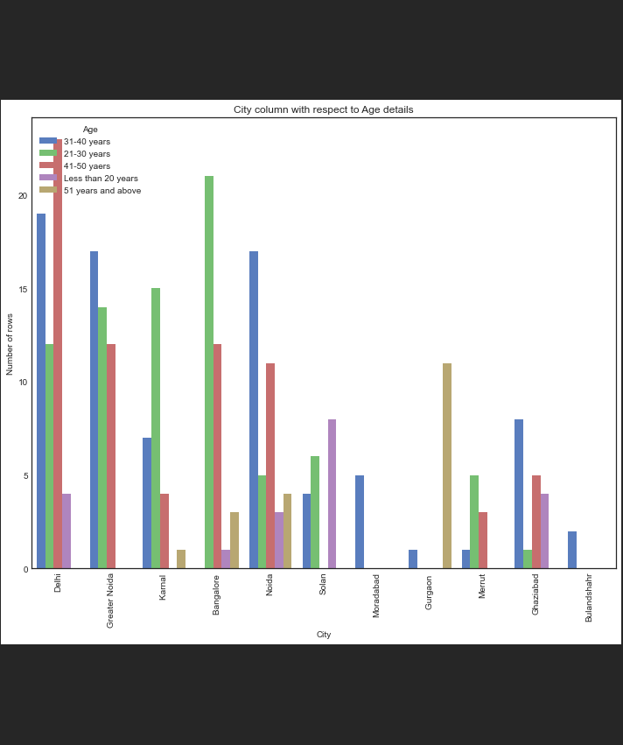
Age Bivariate

Slide 11
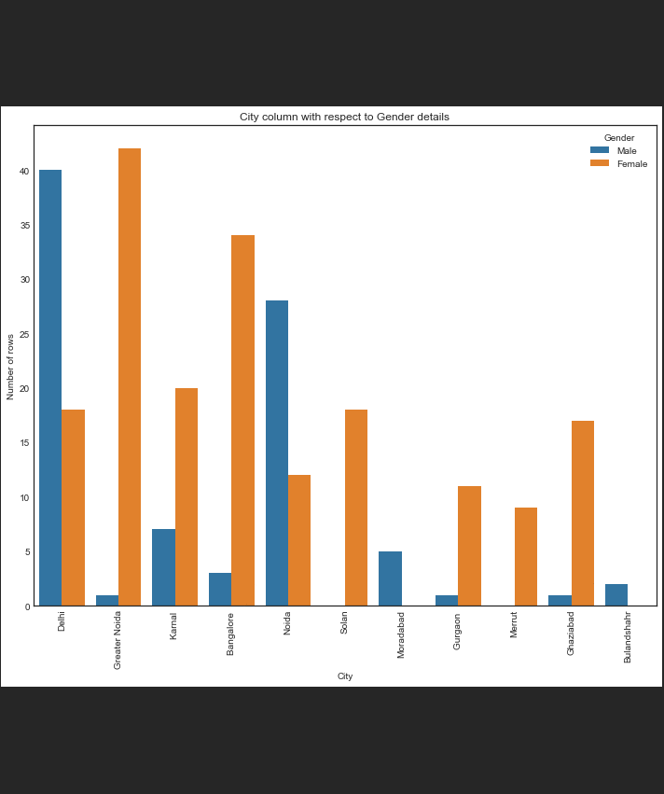
Gender Bivariate

Slide 12
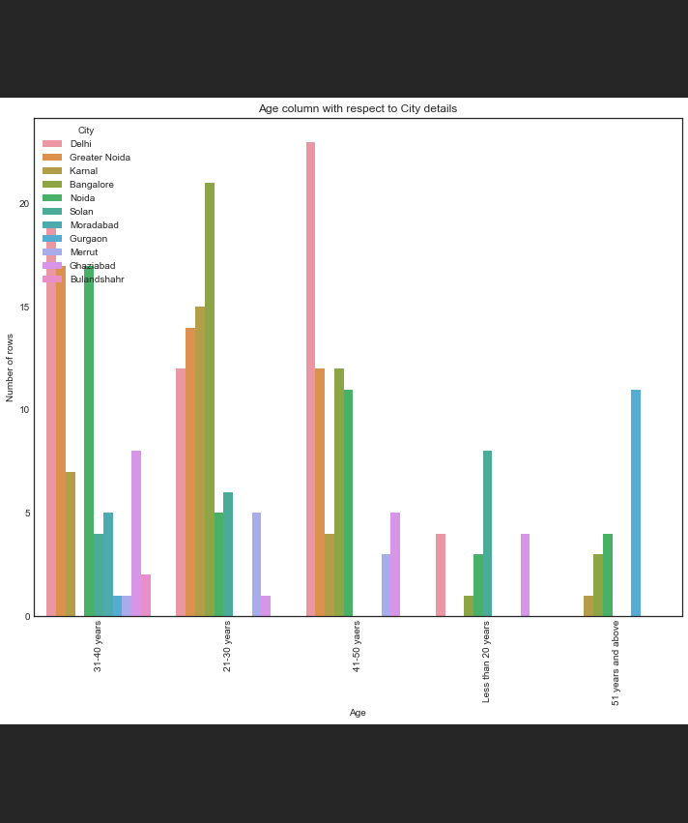
City Bivariate

Slide 13
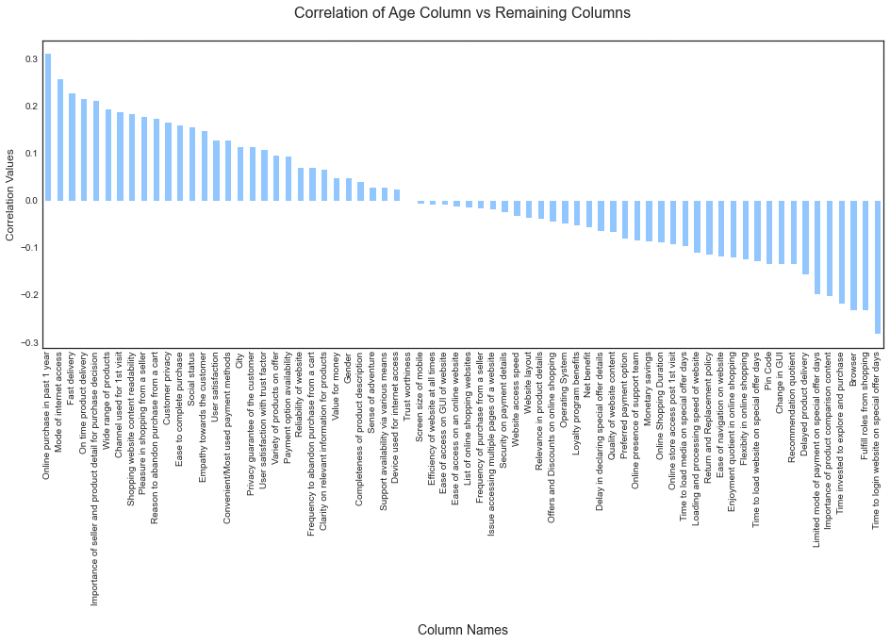
CORRELATION

Slide 14
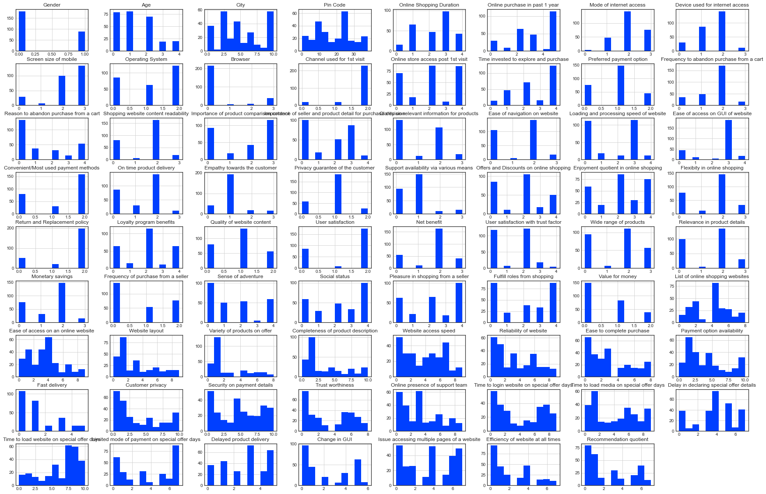
HISTOGRAM

Slide 15
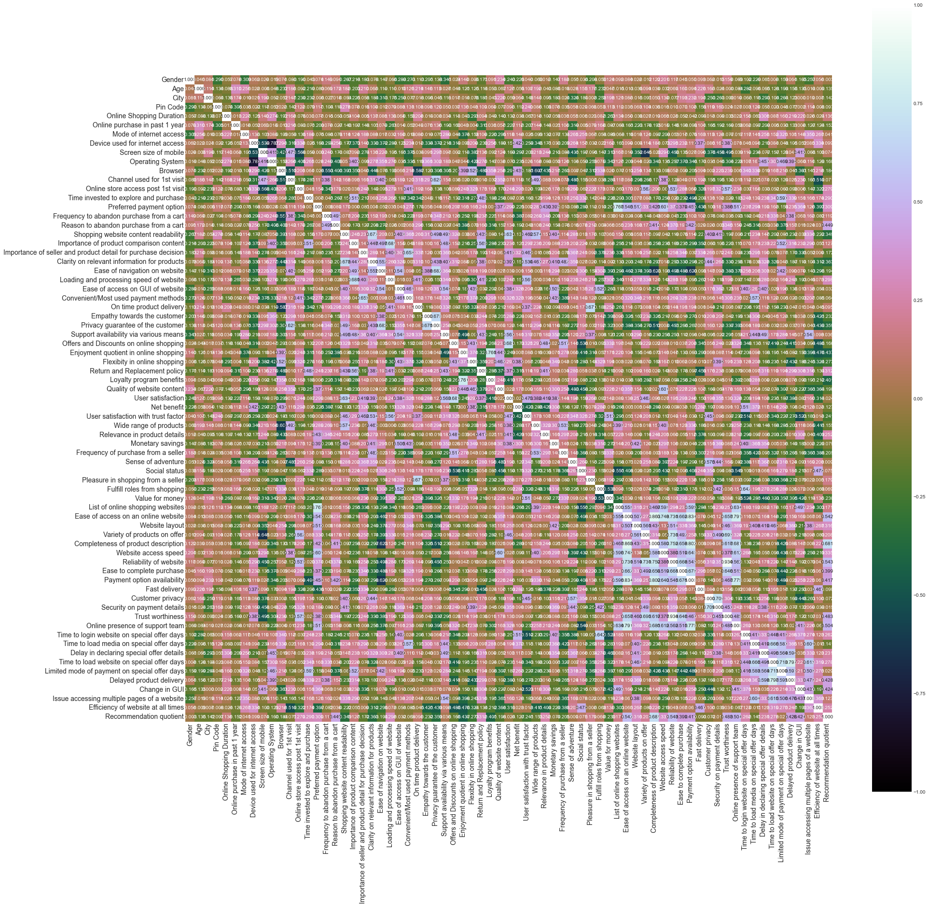
HEATMAP

Slide 16
OBSERVATION
F
FLIPKART
NEED IMPROVEMENT
During promotions, try to give a disturbance free shopping experience to customers.
Flipkart has to bring some certification of product
POSITIVE FEEDBACK
Convenient to use and also a good website for shopping.
Presence of online assistance through multi-channels

Slide 17
OBSERVATION
A
AMAZON
NEED IMPROVEMENT
Reduce the delivery time of the products.
Give more payment options to customers
POSITIVE FEEDBACK
Availability of complete information of the products.
Trustworthy , Return Replacement facilities in Maximum Products.

Slide 18
OBSERVATION
M
MYNTRA
NEED IMPROVEMENT
Try to give the price early during promotions.
Reduce the delivery time of the products during promotions.
POSITIVE FEEDBACK
Different Brand Option Wide range of Brands.
Wide variety of product to offer.

Slide 19
OBSERVATION
P
PAYTM
NEED IMPROVEMENT
Try to give the price early during promotion.
Frequent disturbance is occurring while moving from one page to another.
POSITIVE FEEDBACK
Cashback & Vouchers on Purchases.
Around 20% of the customers believe that paytm has a wild variety of products on offer.

Slide 20
OBSERVATION
S
SNAPDEAL
NEED IMPROVEMENT
Reduce the delivery time of the products during promotions.
No one has expressed to recommend snapdeal to a contact as it has the most negative feedbacks among all other websites.
POSITIVE FEEDBACK
Convenient to use.
54% of the customers are happy about the availability of financial information security.

Slide 21
CONCLUSION
Based on overall observations, the first 47 features provide insights into how e-tailer is helpful & growing based on customer inputs. The data explained how the online platform has been used more often in which CITY,PIN CODE, AGE GROUP, etc. It also showed that in some factors there is less importance given to contribute to the success of an e-commerce store, so based on that we could remove those factors & keep all the important factors, also we could improve on some factors that influence the online customers repeat purchase intention.
It is more difficult for an E- tailer to satisfy the hedonistic desires of the user community because males and females tend to have different hedonistic values.
The utilitarian values analysis revealed that both genders reach a general understanding, making it simpler for an E tailer to concentrate on enhancing its utilities, system qualities, and service qualities.
In this way, consumer loyalty can be maximized. Given that 80% of people use smartphones and laptops, online retailers can adapt their advertisements to be focused on these devices to attract more customers.
Additionally, since 55% of the user base uses e-wallets to finish their purchases, they can offer more deals on e-wallets.
Moreover, the analysis revealed that shorter decision times—typically under 10 minutes—significantly boost the number of transactions a user makes,online retailers can therefore work to reduce the time customers take to make decisions.
This can be accomplished through speeding up loading times, log-in times, price disclosures, and UI improvements.

Slide 22
Thank you
SHREYASI SAHA
officialshreyasi99@gmail.com
www.flipnwork.com

